Slide 1
CPS 109 Lab 2
Gurpreet Kaur

Slide 2


Agenda
A
Introduction
Housekeeping
Logging in
Introduction
Operators
Comparators

Slide 3
Introduction
If using own devices, then
Visit python.org and download the latest available version.
Anaconda navigator can be used to have exposure of most IDE’s
VS Code can be used too.

Slide 4
Housekeeping
Any login issues??

Slide 5
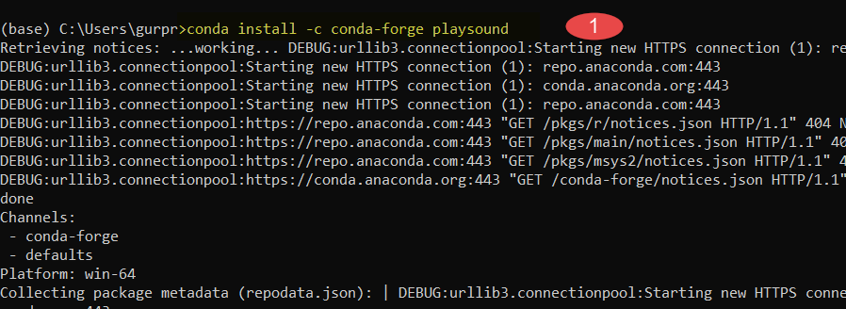
Importing External Modules
External modules can be added using import statement .
Lets see an example on anaconda navigator

Slide 6
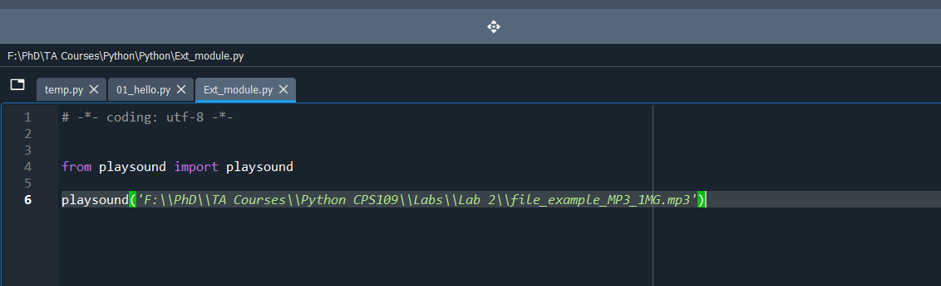
Further Steps : Python Script

Slide 7
Variables in Python
Lets Discuss?
What are Variables ?
Are they allocated a memory space?

Slide 8
Special about Python
In Python, Value of variable is allocated a memory address not the name of Variable.
A=10
B=10 ( have same address as value is same )

Slide 9
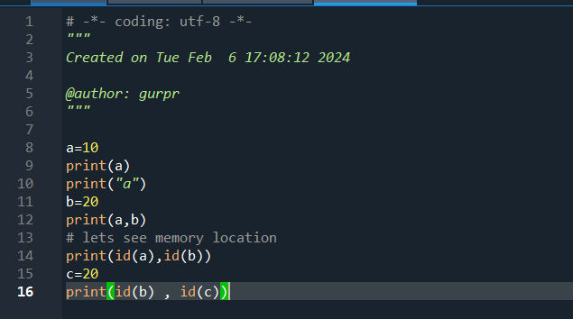
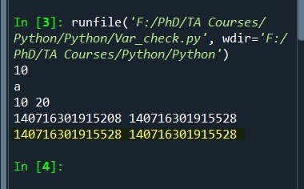
Example: var_check.py

Slide 10
Rules for Naming Variables
Never starts with a number
Is 15a=10 (Valid)
Does not include whitespaces.
Is Full name = “John Smith” Valid??
Only underscore ( _ ) can be used while naming variables .

Slide 11
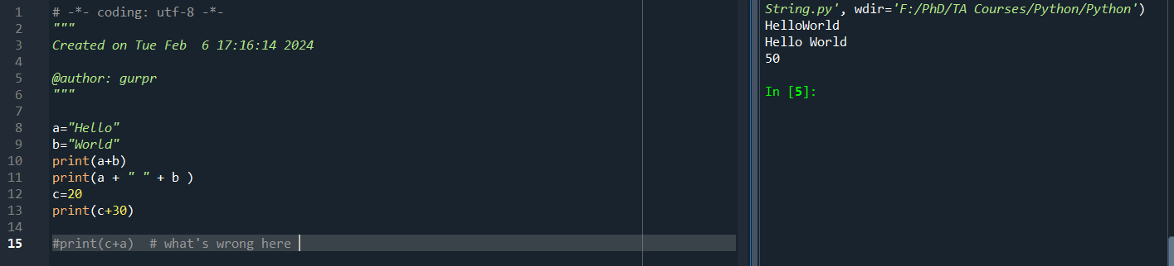
String Concatenation in Python : String.py

Slide 12
Operators in Python
deploy strategic networks with compelling e-business needs
Arithmetic
Addition, Subtraction, Division, Multiplication, Modulus, Exponents, Floor Division
Assignment
disseminate standardized metrics
Comparison
coordinate e-business applications
foster holistically superior methodologies
Membership
Logical

Slide 13
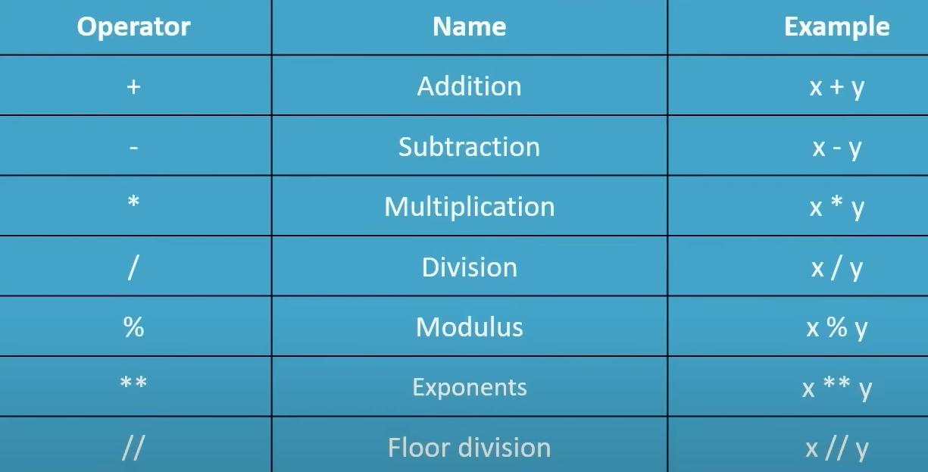
Arithmetic Operators

Slide 14
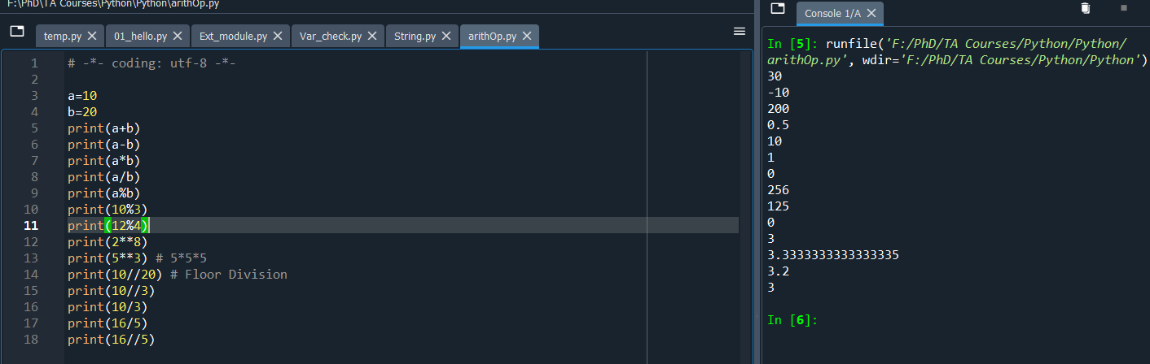
Example : arithOp.py

Slide 15
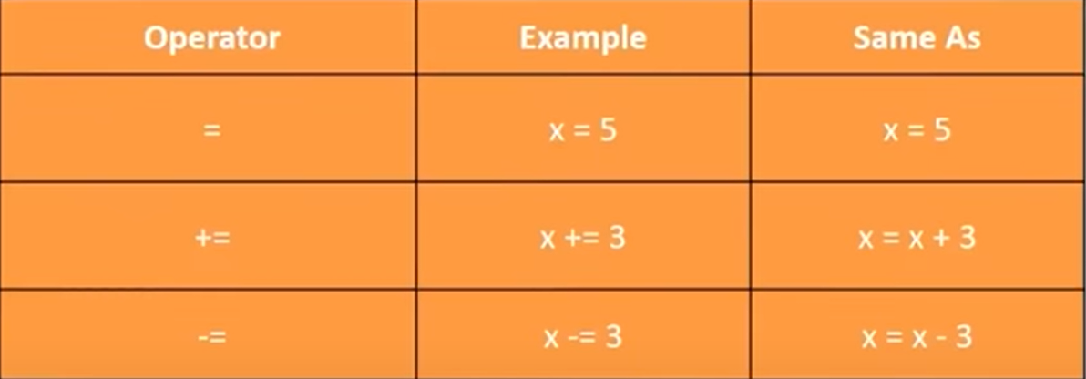
Assignment Operators

Slide 16
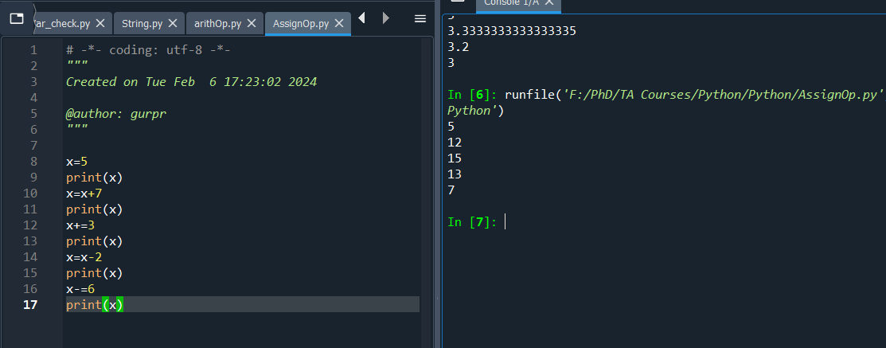
Example: AssignOp.py

Slide 17
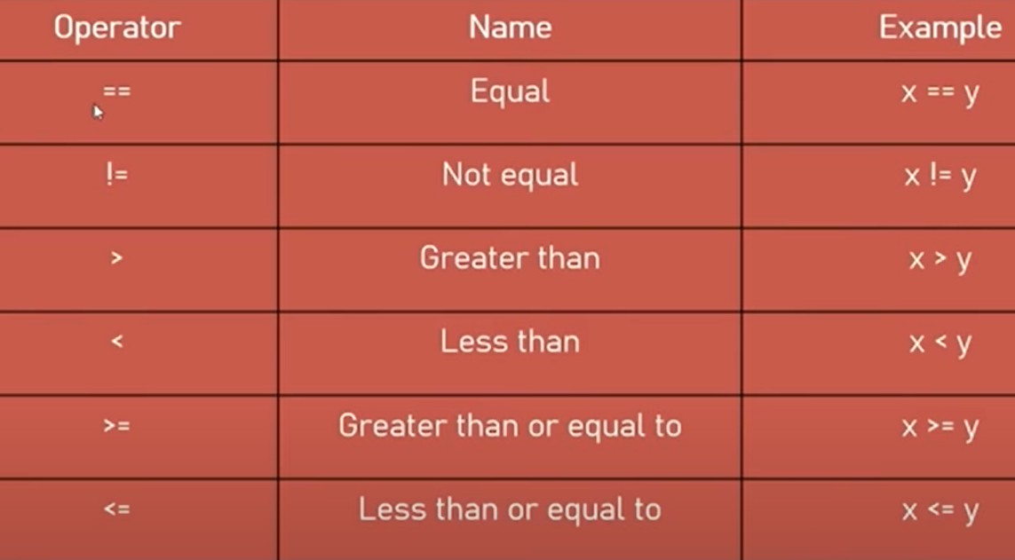
Comparison Operators

Slide 18
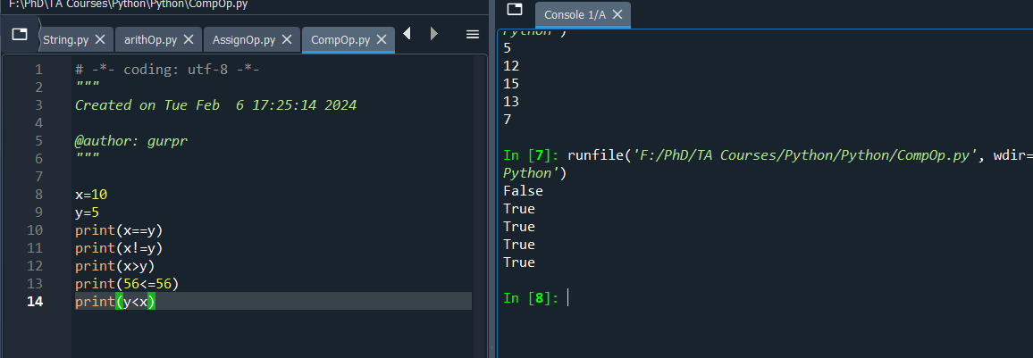
Example: CompOp.py

Slide 19
Mojan will continue with
Logical operators
If else statements

Slide 20
Thank you
Gurpreet Kaur
(gurpreetkaur.kaur@torontomu.ca)
Mojan Nooshin
mnooshin@torontomu.ca

